Slide 1

Unit 10

Slide 2
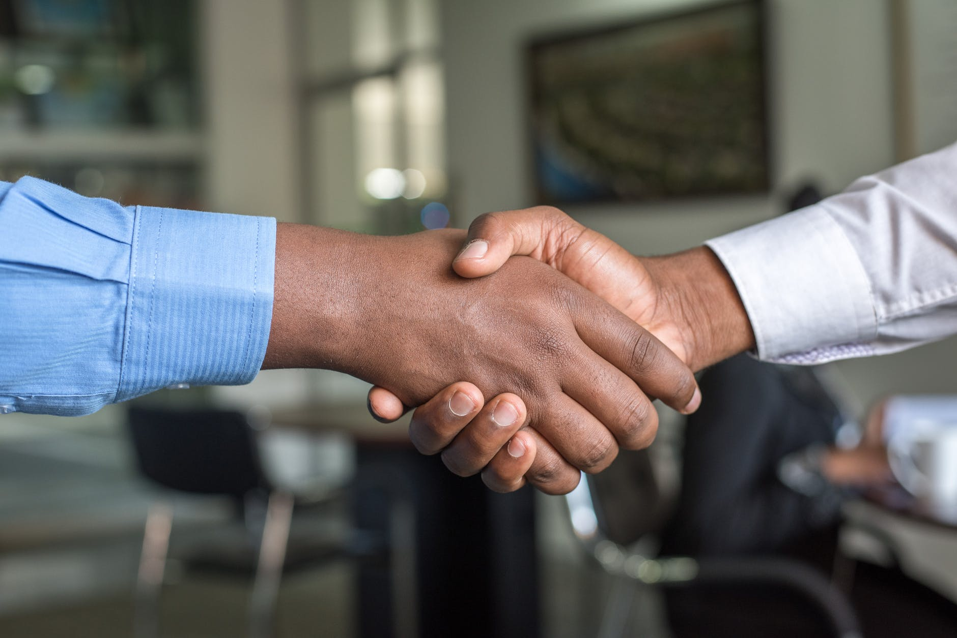
Unit 10
You're supposed to shake hands.

Slide 3
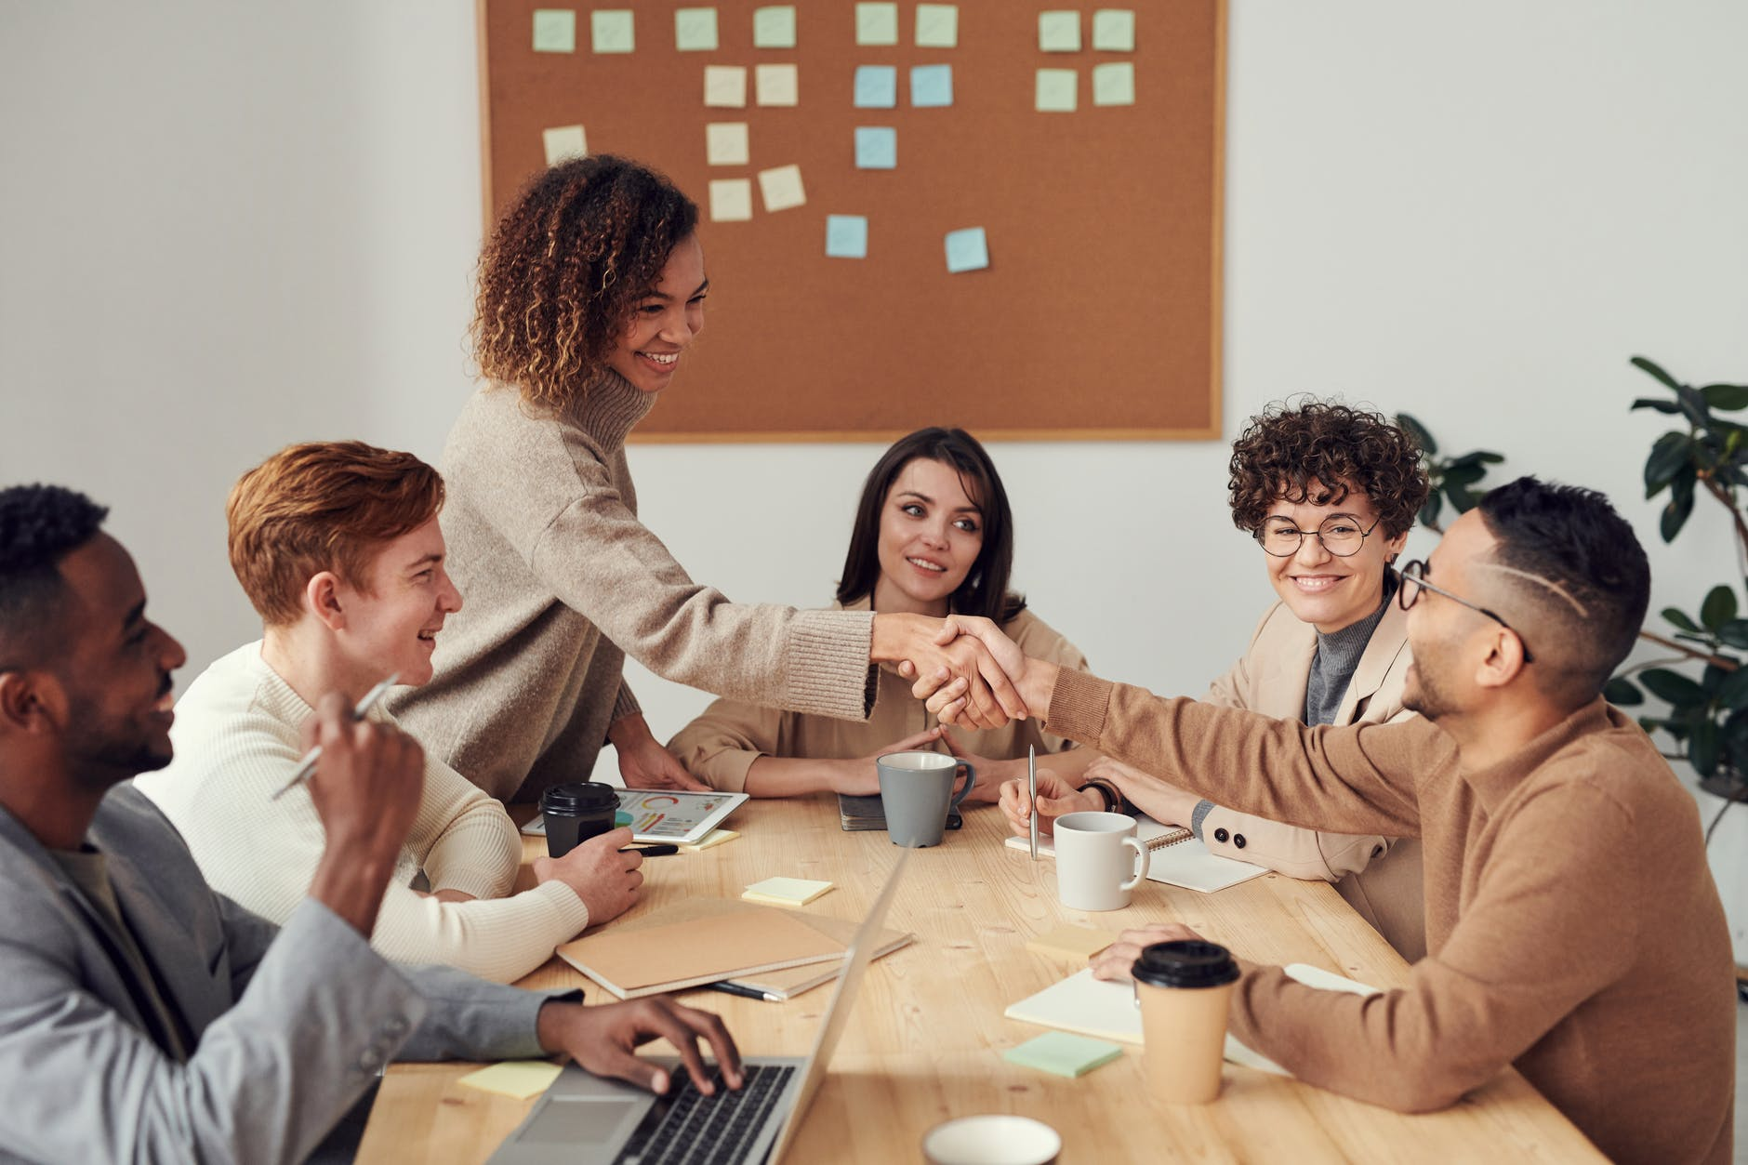
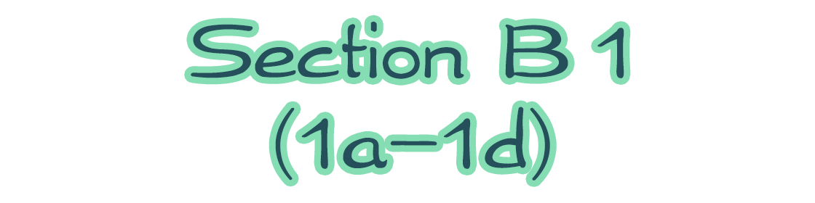

Slide 4



To learn about table manners in different countries.
To get specific information according to the listening materials.

Slide 5


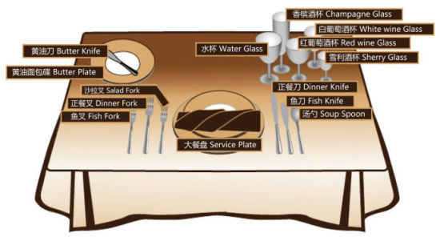
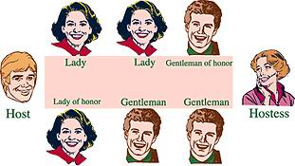
Table manners in foreign countries
in France

Slide 6
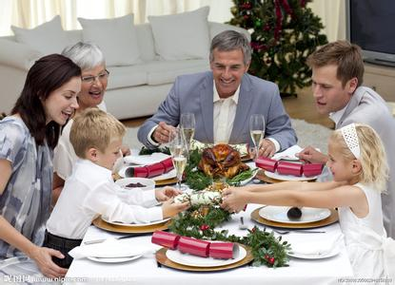
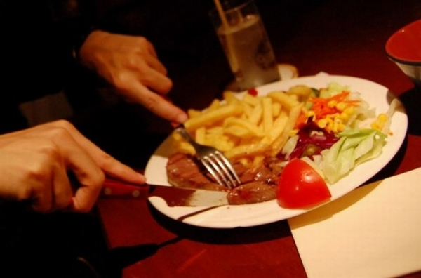


Slide 7
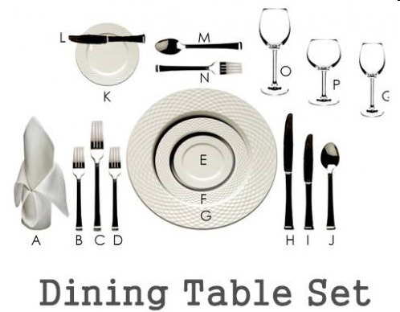


What should we notice in a Western meal?
shake legs
make noise
smoke
lady first
put your napkin on legs
fork in left knife in right
talk when your food is in the mouth
put your hands on the table

Slide 8
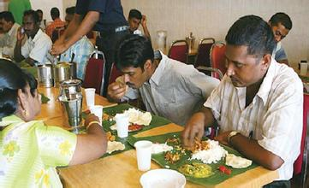
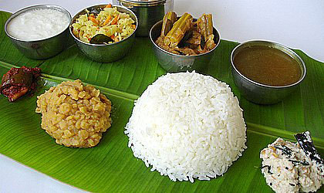
in India

Slide 9

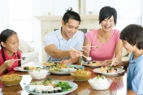
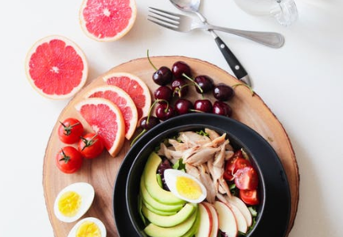
A quiz
How much do you know about table manners around the world? Take the following quiz. Circle T for true or F for false after each sentence.
1a

Slide 10
Mind your manners!
1. In India, you’re supposed to eat with your hands. T F
2. In China, you’re not supposed to stick your chopsticks into the food. T F
3. In Korea, the youngest person is expected to start eating first. T F
4. In France, you’re supposed to put your bread on the table. T F
5. In China, it’s impolite to use your chopsticks to hit an empty bowl. T F

Slide 11

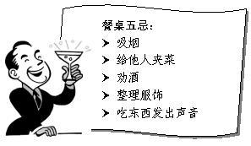
As Chinese, do you know
what table manners in China?

Slide 12
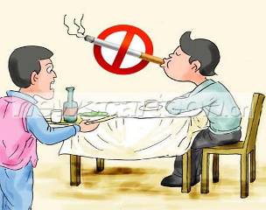
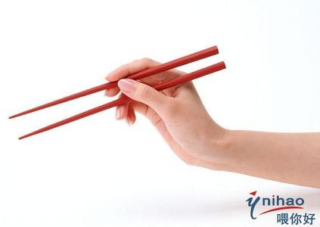
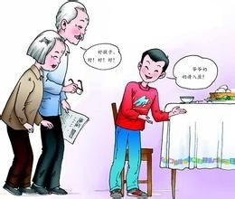
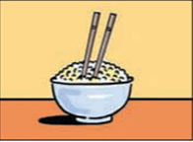
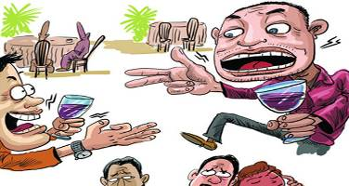
Which table manners are right?

Slide 13
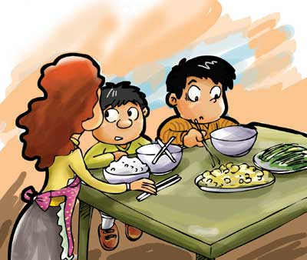
Chinese Table Manners
We are not supposed to eat with hands.
chopsticks
We should eat with our ____________.

Slide 14
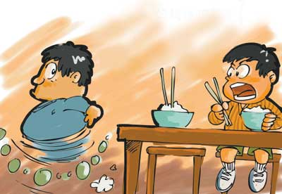
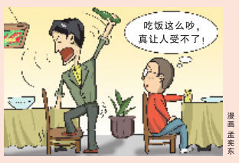
into
It’s rude to _____ the chopsticks ____
the food.
We’re not supposed to _________ at
the table.
stick
talk aloud

Slide 15
Do you know what other table manners in China?
We shouldn’t ________ others while eating the meals. (指)
point at
We aren’t supposed to __________ while eating the meals. (发出响声)
make noise

Slide 16
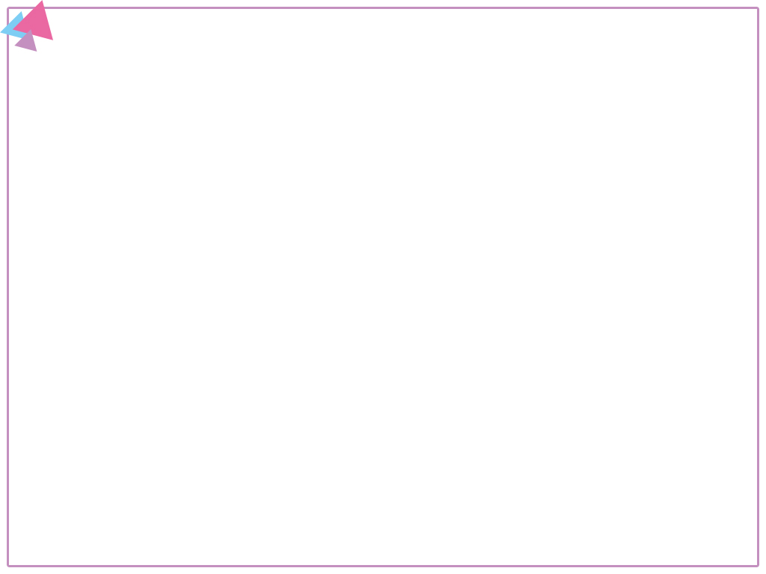


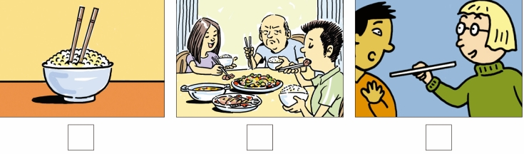
1b
Steve is going to China to study. His friend Yang Ming is telling him about the table manners in China. Listen and number the pictures in the order you hear them.
2
1
3

Slide 17
1c
Listen again. Match these sentence parts.
____ 1. You’re not supposed to… ____ 2. It’s impolite to… ____ 3. You shouldn’t… | a. stick your chopsticks into your food. b. point at anyone with your chopsticks. c. start eating first if there are older people at the table.
c
a
b

Slide 18
Listen for the third time, then complete the conversation.
Yang Ming: You must be excited about _______________ tomorrow, Steve!
Steve: Yeah, but I’m a little _______, too.
Yang Ming: Why?
Steve: Well, for one thing, I don’t know ___________________ very well… and I don’t know how to _______ at the dinner table.
leaving for China
nervous
how to use chopsticks
behave

Slide 19
Yang Ming: Oh, I see. Well, one important thing is that you _________________ start eating first if there are ___________ at the table.
Steve: That’s _________. In the United States, it doesn’t matter.
Yang Ming: Yeah, I know. It’s also _______ to stick your chopsticks into your food. You ______________________ with your chopsticks, either.
are not supposed to
older people
interesting
impolite
shouldn’t point at anyone

Slide 20
Steve: Oh, OK.
Yang Ming: Oh, and there’s one more thing you need to know. You’re not supposed to __________________________. Only parents ______________ talk at the dinner table. Children are not allowed to _____.
Steve: Wow! That’s… that’s unusual!
Yang Ming: Haha, I’m just _______!
talk when you’re eating dinner
are expected to
speak
kidding

Slide 21

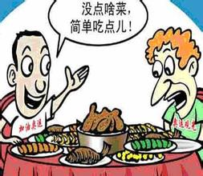
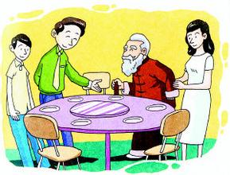
Talk about other table manners in your country.
1d
A: We are supposed to…
B: Yes, and it’s impolite to…

Slide 22
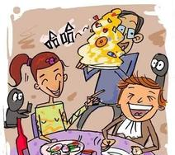
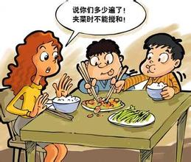
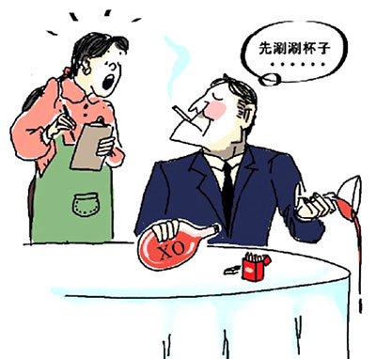

Slide 23

Talk about Chinese table manners and write down your opinions.
1. You’re not supposed to start eating first if there are older people at the table.
2. You shouldn’t point at anyone with
your chopsticks.
3. It’s impolite to stick your chopsticks into your food.

Slide 24
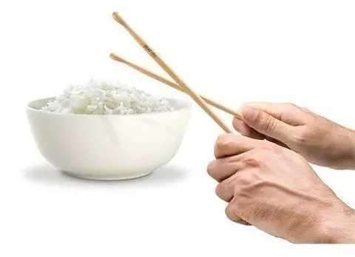
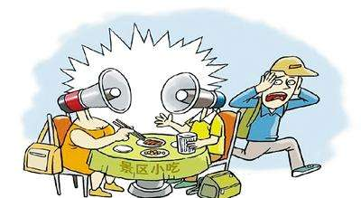
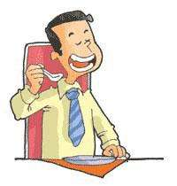
4. It’s impolite to use your chopsticks to hit an bowl.
5. You are not supposed to talk when you’re having dinner.
6. It’s not necessary to order too many dishes.
7. It’s impolite to make a big noise when you are eating soup.

Slide 25


Mind your manners!
mind…注意……; 当心；小心……
警示句型。
e.g. Mind your head, please.
请注意你的头。

Slide 26
v. 介意，常用于否定句和疑问句，后接名词(短语)、代词、动词-ing形式或从句。
【语境应用】单项选择。
1) I don’t _______ the heat, for I’m used
to hot weather.
A. like B. mind
C. know D. stand
B

Slide 27
2) I wouldn’t mind _____ a roommate. We can help each other and save money as well.
A. having B. to have
C. have D. had
A

Slide 28
manners n. 礼貌；规矩；礼仪；方式。manner通常用复数形式。
e.g. 满嘴食物说话是不礼貌的行为。(翻译)
It’s bad manners to talk with your
mouth full.

Slide 29


把筷子插进食物里
stick your chopsticks into the food
用你的筷子敲空碗
use your chopsticks to hit an empty bowl
用筷子指着任何人
point at anyone with your chopsticks

Slide 30
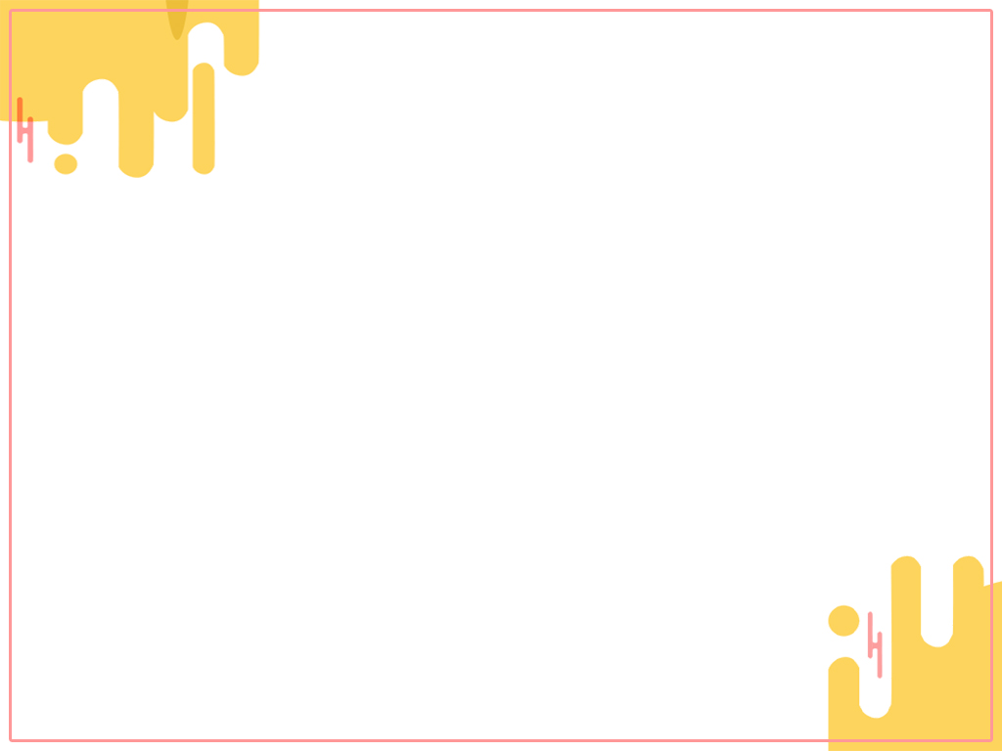

1. Find the differences about the table
manners between France and China
on the Internet.
2. Preview the reading passage on page 78.

Slide 31
